Slide 1
Machine Learning
What is Machine Learning and What is Artificial Intelligence?

Slide 2
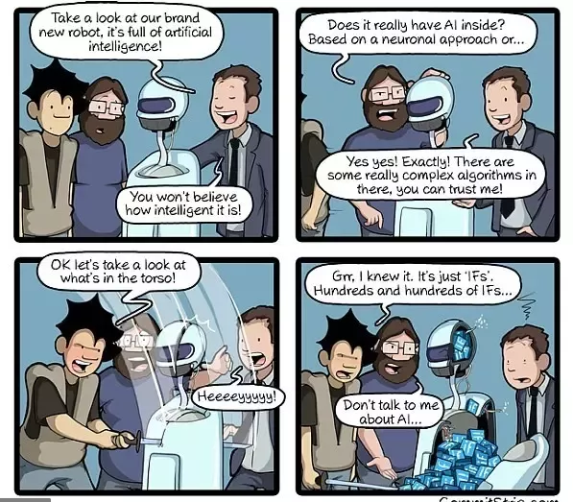
Artificial Intelligence ( AI ) means getting a computer to mimic human behavior in some way.
Machine learning is a subset of AI, and it consists of the techniques that enable computers to figure things out from the data and deliver AI applications.

Slide 3
Introduction
Machine Learning
- Grew out of work in AI
- New capability for computers
Examples:
- Database mining
Large datasets from growth of automation/web.
E.g., Web click data, medical records, biology, engineering
Applications can’t program by hand.
E.g., Autonomous helicopter, handwriting recognition, most of Natural Language Processing (NLP), Computer Vision.
- Self-customizing programs E.g., Amazon, Netflix product recommendations
- Understanding human learning (brain, real AI).

Slide 4
A Formal Definition
Arthur Samuel (1959). Machine Learning:
Field of study that gives computers the ability to learn without being explicitly programmed.
Tom Mitchell (1998) Well-posed Learning Problem:
A computer program is said to learn from experience E with respect to some task T and some performance measure P, if its performance on T, as measured by P, improves with experience E.
Example: playing checkers.
E = the experience of playing many games of checkers
T = the task of playing checkers.
P = the probability that the program will win the next game

Slide 5
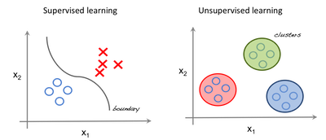
GENERAL CLASSIFICATION
In general, any machine learning problem can be assigned to one of two broad classifications:
Supervised learning
OR
Unsupervised learning.

Slide 6


Supervised Learning
In supervised learning, we are given a data set and already know what our correct output should look like, having the idea that there is a relationship between the input and the output.
Examples:
1)You get bunch of photos with information what is on them and you train a model to recognize new photos
2)And based on past information about spams, filtering out a new incoming email into Inbox (normal) or Junk folder (Spam)
Spam
The Model

Slide 7
Unsupervised learning
Unsupervised learning is the training of machine using information that is neither classified nor labeled and allowing the algorithm to act on that information without guidance.
Example
Let's suppose you have never seen a Cricket match before and by chance watch a video on internet, now you can classify players on the basis of different criterion:
Players wearing same sort of kits are in one class,
Players of one style are in one class (batsmen, bowler, fielders),
or on the basis of playing hand (RH vs LH)
or whatever way you would observe [and classify] it.

Slide 8
Supervised learning problems are categorized into "regression" and "classification" problems.
-> In a regression problem, we are trying to predict results within a continuous output, meaning that we are trying to map input variables to some continuous function.
Regression Example : Given a picture of Male/Female, We have to predict his/her age on the basis of given picture.
-> In a classification problem, we are instead trying to predict results in a discrete output. In other words, we are trying to map input variables into discrete categories.
Classification Example : Based on past information about spams, filtering out a new incoming email into Spam or Not Spam.

Slide 9
Regression or Classification
Problem 1 : Based on some prior knowledge (when its sunny, temperature is higher; when its cloudy, humidity is higher, etc.) weather apps predict the parameters for a given time
Problem 2 : You’d like software to examine individual customer accounts, and for each account decide if it has been hacked/compromised
Answers :
1) Regression
2) Classification

Slide 10
Regression Analysis
In all the regression examples we predict the unknown value of a quantity from the given set of data.
Regression analysis is a statistical process for estimating relationship among variables.
It is also used to understand which among the independent variables are related to the dependent variables.

Slide 11
Linear Regression

Slide 12
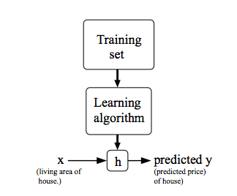
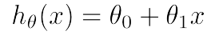
Linear Regression
Linear regression models assume that the relationship between a dependent continuous variable Y and one or more independent variables X is linear (that is, a straight line).
It’s used to predict values within a continuous range (e.g. sales, price)
In other words, there exist a linear relationship between independent and dependent variables.

Slide 13
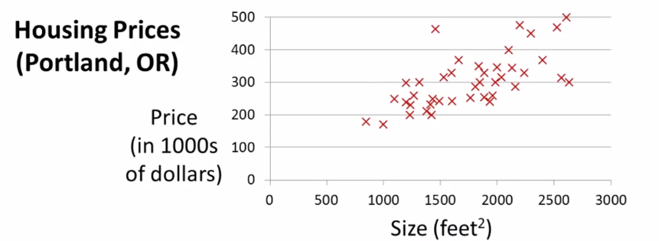

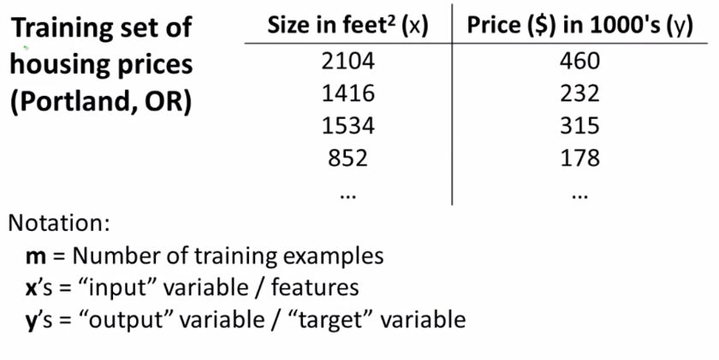
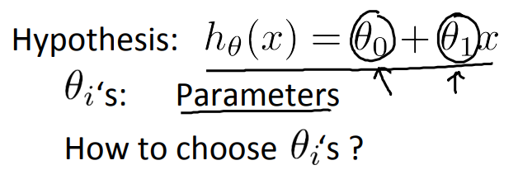

Slide 14
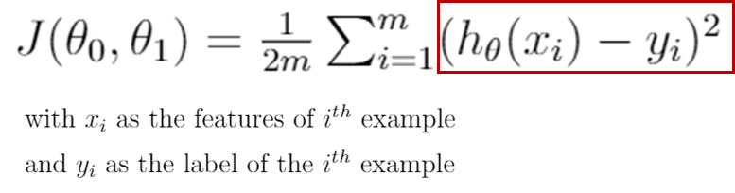
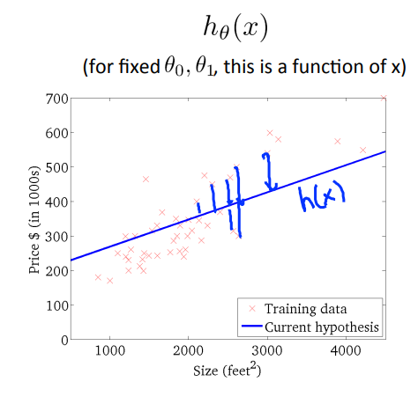
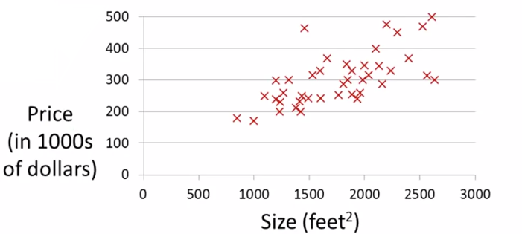
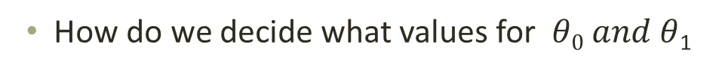
Cost function
How do we decide what values for $θ0 and θ$₁

Slide 15
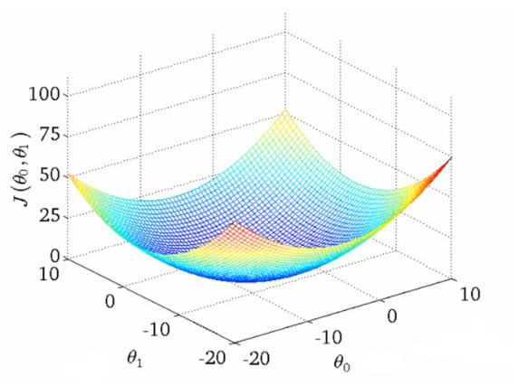
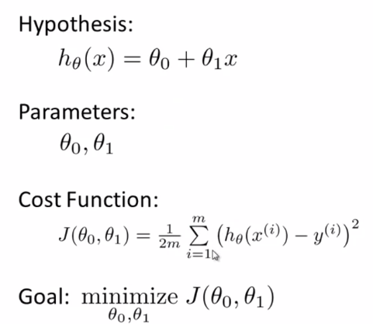
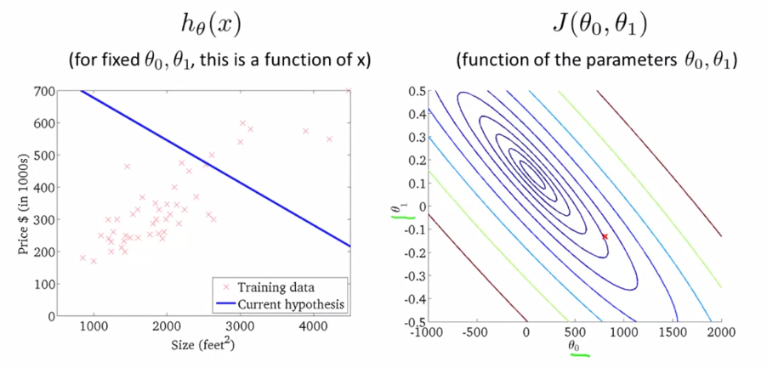
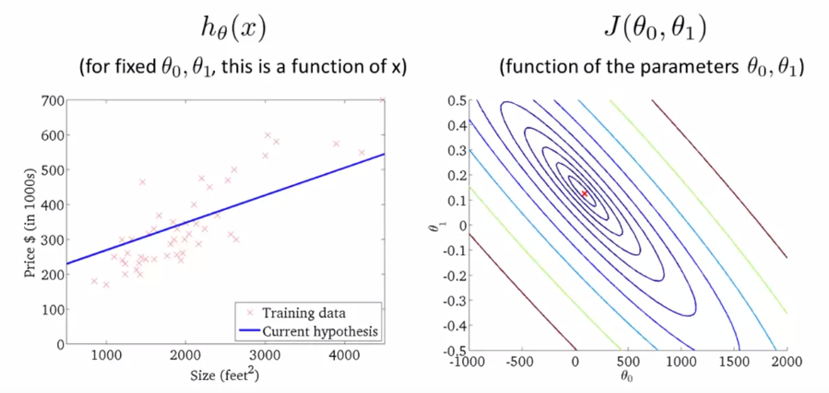
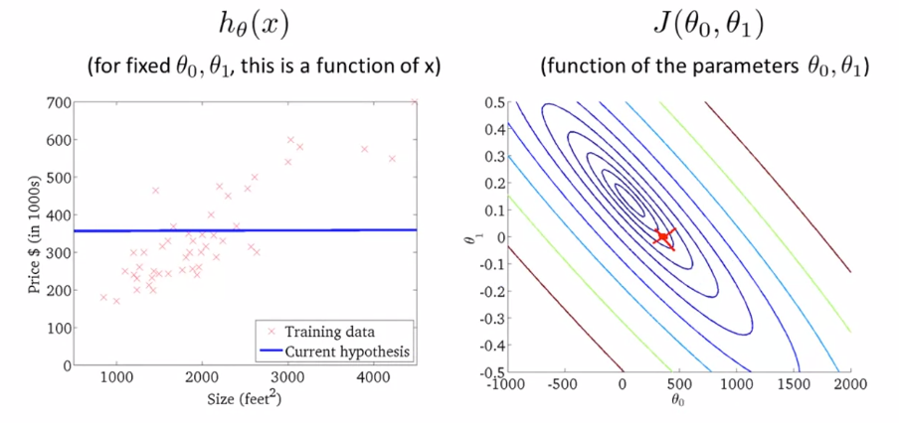
Summary

Slide 16
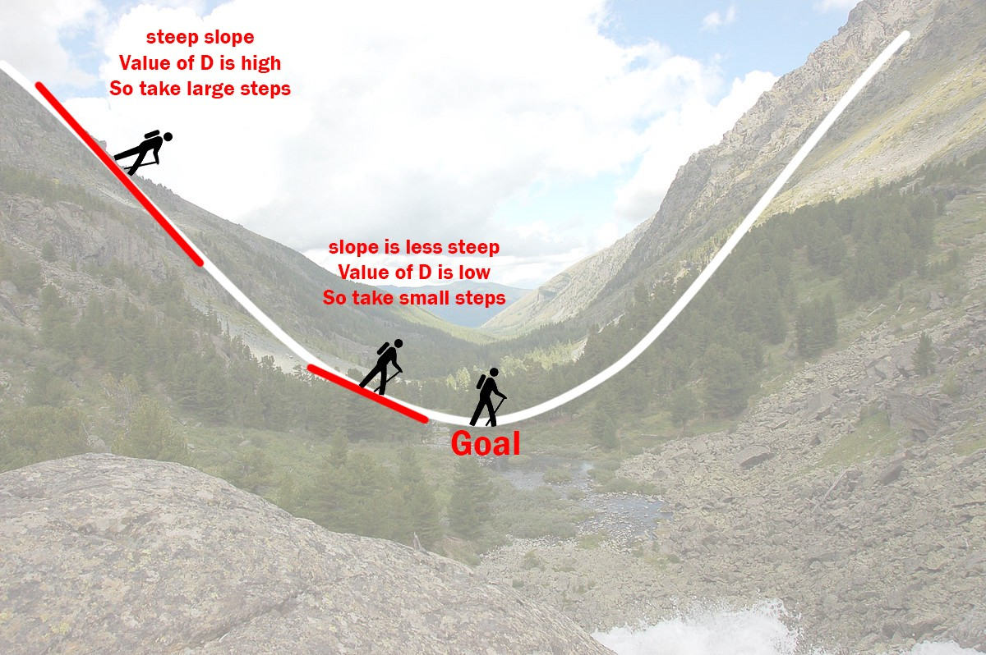
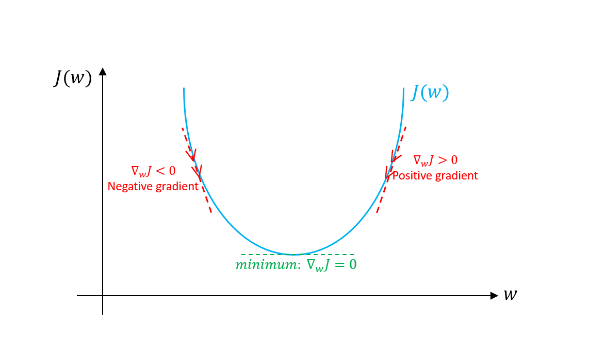
Intuition – Gradient Descent

Slide 17
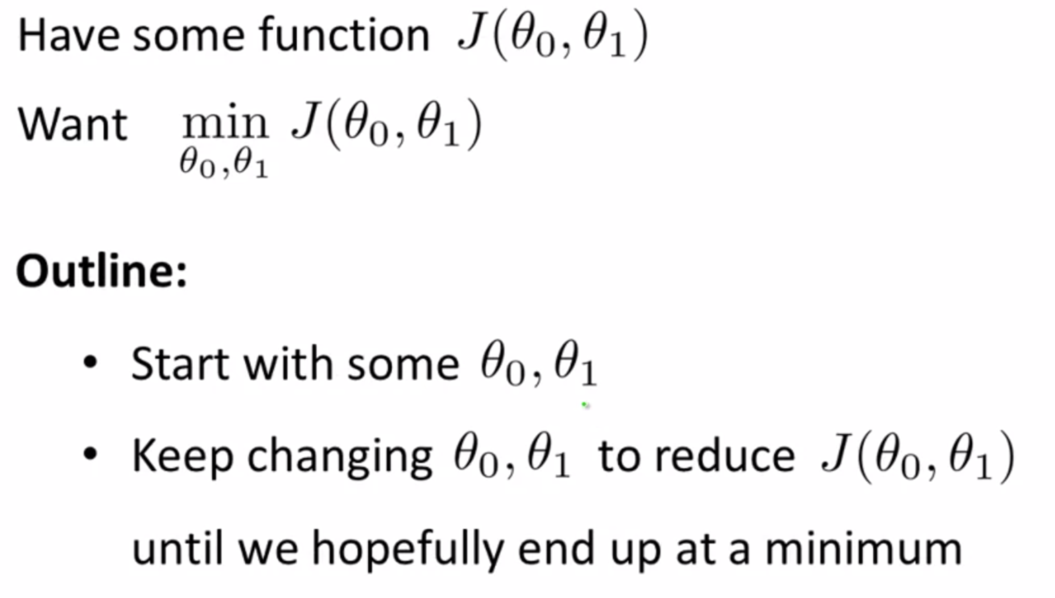
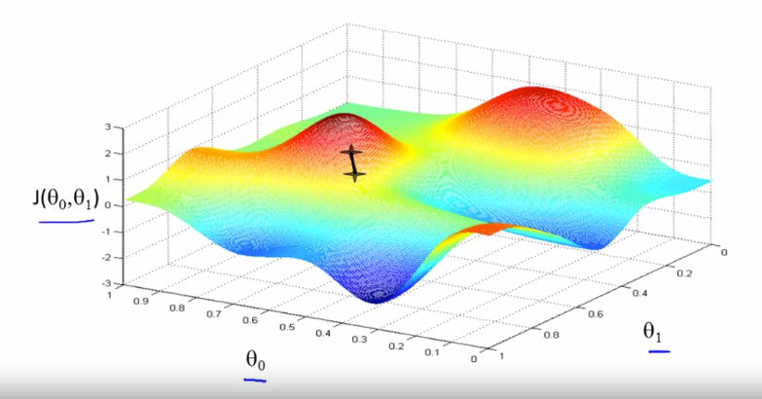
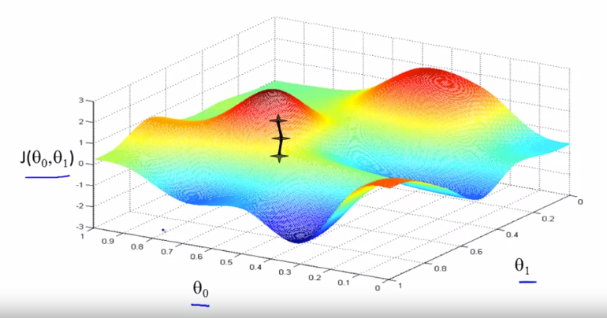
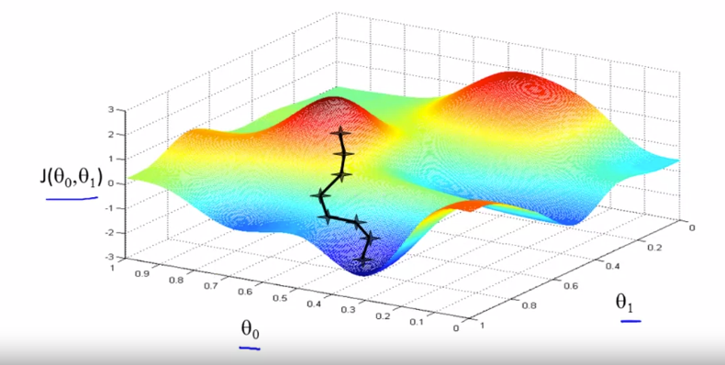
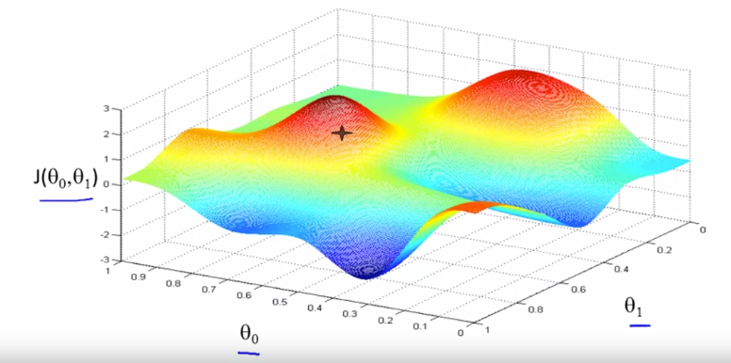
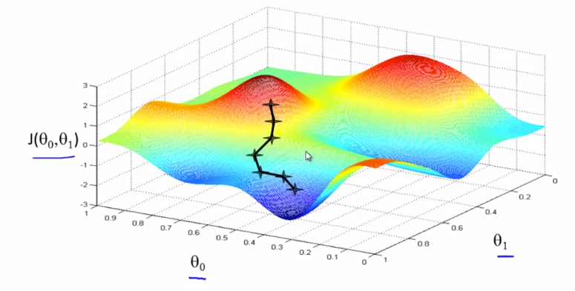
Gradient Descent

Slide 18
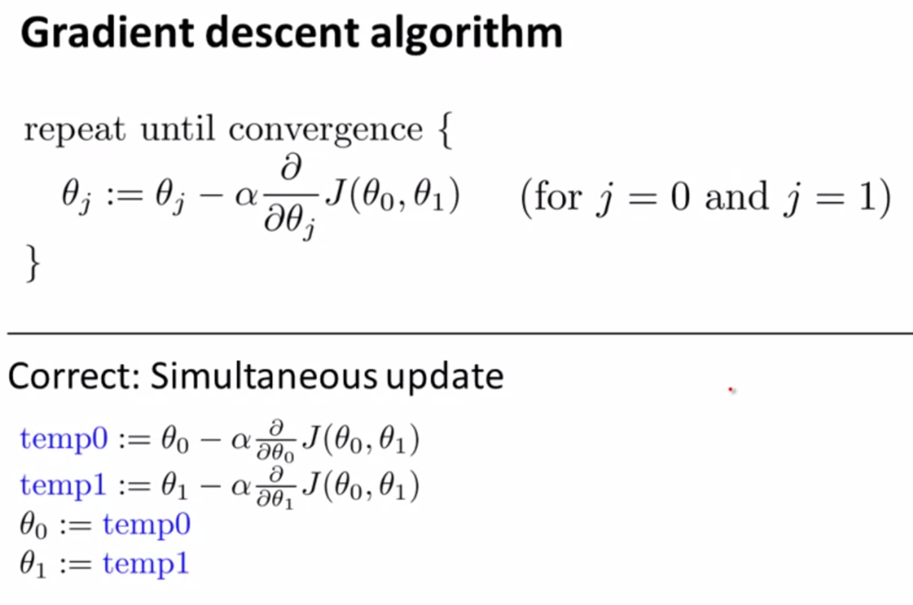
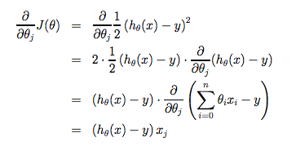
Algorithm for Gradient Descent
Regardless of the slope's sign for the function will​ eventually converges to its minimum value
On a side note, we should adjust our parameter α to ensure that the gradient descent algorithm converges in a reasonable time.
Failure to converge or too much time to obtain the minimum value imply that our step size is wrong

Slide 19
Logistic Regression

Slide 20
Logistic regression
Classification techniques are an essential part of machine learning and data mining applications.
Approximately 70% of problems in Data Science are classification problems. There are lots of classification problems that are available, but the logistics regression is common and is a useful regression method for solving the binary classification problem.
Another category of classification is Multinomial classification, which handles the issues where multiple classes are present in the target variable

Slide 21
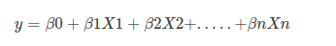
Logistic Regression
Logistic regression is a statistical method for predicting binary classes. The outcome or target variable is dichotomous in nature. Dichotomous means there are only two possible classes. For example, it can be used for cancer detection problems. It computes the probability of an event occurrence.
It is a special case of linear regression where the target variable is categorical in nature. It uses a log of odds as the dependent variable. Logistic Regression predicts the probability of occurrence of a binary event utilizing a logit function.
Linear Regression Equation:
Where, y is dependent variable and x1, x2 ... and Xn are explanatory variables.
Sigmoid Function:

Slide 22
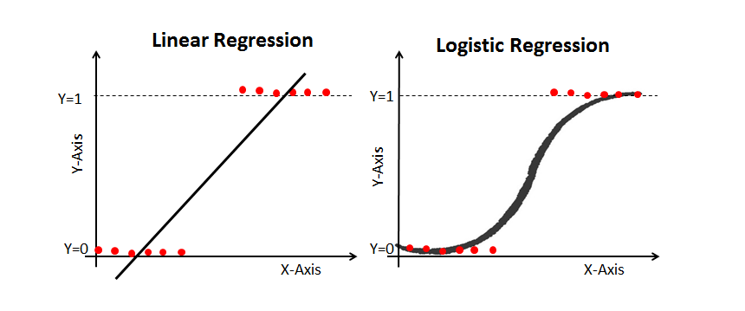
Linear Regression Vs. Logistic Regression
Linear regression gives you a continuous output, but logistic regression provides a constant output. An example of the continuous output is house price and stock price.
Example's of the discrete output is predicting whether a patient has cancer or not, predicting whether the customer will churn.
Linear regression is estimated using Ordinary Least Squares (OLS) while logistic regression is estimated using Maximum Likelihood Estimation (MLE) approach.

Slide 23
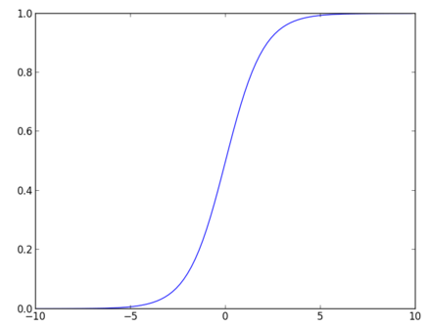
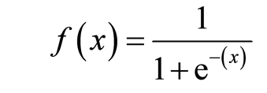
Sigmoid Function
The sigmoid function, also called logistic function gives an ‘S’ shaped curve that can take any real-valued number and map it into a value between 0 and 1.
If the curve goes to positive infinity, y predicted will become 1, and if the curve goes to negative infinity, y predicted will become 0. If the output of the sigmoid function is more than 0.5, we can classify the outcome as 1 or YES, and if it is less than 0.5, we can classify it as 0 or NO.
For example: If the output is 0.75, we can say in terms of probability as: There is a 75 percent chance that patient will suffer from cancer.

Slide 24
Under fitting
This is when the model cannot capture the underlying trend of the data.
Underfitting destroys the accuracy of our machine learning model. Its occurrence simply means that our model or the algorithm does not fit the data well enough.
It usually happens when we have less data to build an accurate model for example when we try to build a linear model with a non-linear data.
In such cases the rules of the machine learning model are too easy and flexible to be applied on such a minimal data and therefore the model will probably make a lot of wrong predictions.
Underfitting can be avoided by using more data and also reducing the features by feature selection.

Slide 25
Over fitting
The model is said to be overfitted, when we train it with a lot of data.
When a model gets trained with so much of data, it starts learning from the noise and inaccurate data entries in our data set.
So you will get very high training accuracy, but very slow validation accuracy.
Then the model does not categorize the data correctly, because of too much of details and noise.
The causes of overfitting are the non-parametric and non-linear methods because these types of machine learning algorithms have more freedom in building the model based on the dataset and therefore they can really build unrealistic models.

Slide 26
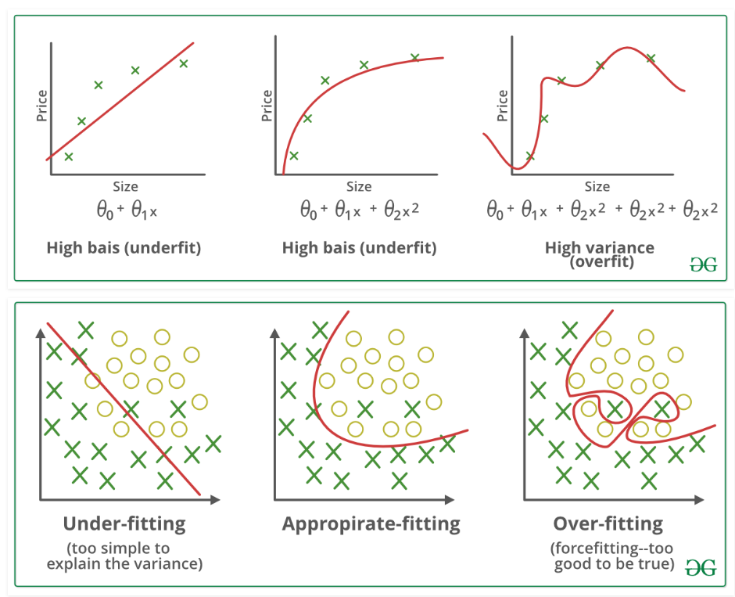

Slide 27

